Slide 1
Chapter 4 : Intermediate SQL

Slide 2
Outline
Join Expressions
Views
Integrity Constraints
SQL Data Types and Schemas
Authorization
Notes:
1

Slide 3
Joined Relations
Join operations take two relations and return as a result another relation.
A join operation is a Cartesian product which requires that tuples in the two relations match (under some condition). It also specifies the attributes that are present in the result of the join
The join operations are typically used as subquery expressions in the from clause
Three types of joins:
Natural join
Inner join
Outer join

Slide 4
Natural Join in SQL
Natural join matches tuples with the same values for all common attributes, and retains only one copy of each common column.
List the names of instructors along with the course ID of the courses that they taught
select name, course_id from students, takes where student.ID = takes.ID;
Same query in SQL with “natural join” construct
select name, course_id from student natural join takes;

Slide 5
Natural Join in SQL (Cont.)
The from clause can have multiple relations combined using natural join:
select A₁, A₂, … A_{n} from r₁ natural join r₂ natural join .. natural join r_{n} where P ;

Slide 6
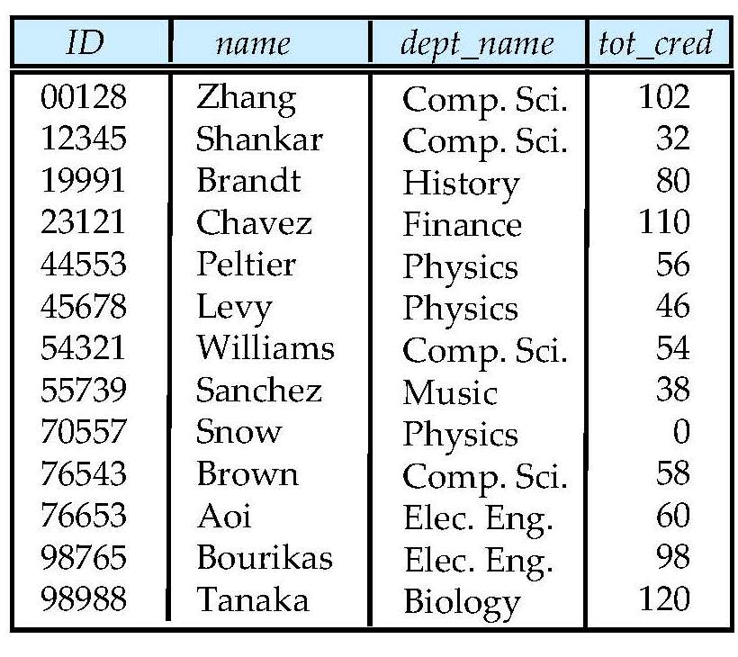
Student Relation

Slide 7
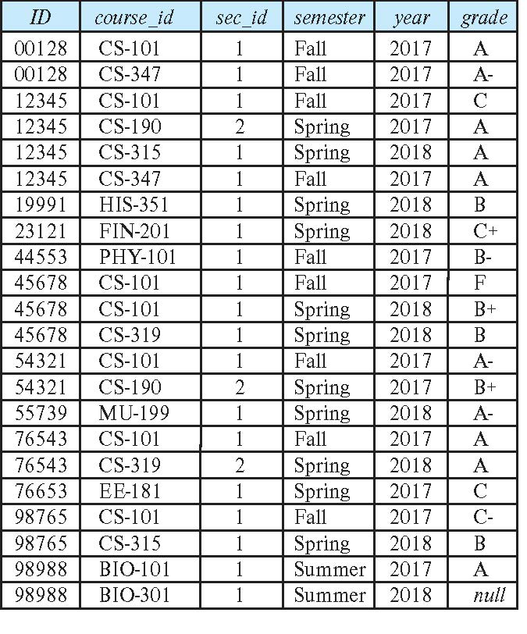
Takes Relation

Slide 8
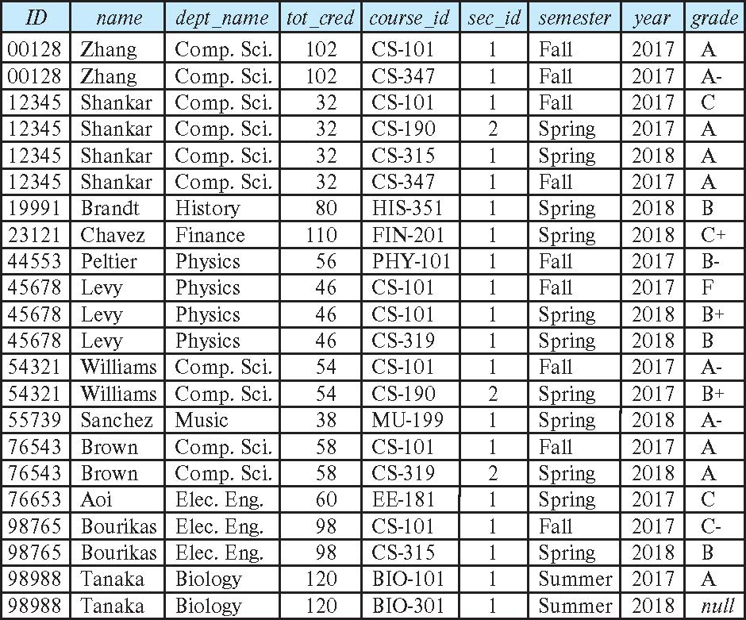
student natural join takes

Slide 9
Dangerous in Natural Join
Beware of unrelated attributes with same name which get equated incorrectly
Example -- List the names of students instructors along with the titles of courses that they have taken
Correct version
select name, title from student natural join takes, course where takes.course_id = course.course_id;
Incorrect version
select name, title from student natural join takes natural join course;
This query omits all (student name, course title) pairs where the student takes a course in a department other than the student's own department.
The correct version (above), correctly outputs such pairs.

Slide 10
Natural Join with Using Clause
To avoid the danger of equating attributes erroneously, we can use the “using” construct that allows us to specify exactly which columns should be equated.
Query example
select name, title from (student natural join takes) join course using (course_id)

Slide 11
Join Condition
The on condition allows a general predicate over the relations being joined
This predicate is written like a where clause predicate except for the use of the keyword on
Query example
select * from student join takes on student_ID = takes_ID
The on condition above specifies that a tuple from student matches a tuple from takes if their ID values are equal.
Equivalent to:
select * from student , takes where student_ID = takes_ID

Slide 12
Join Condition (Cont.)
The on condition allows a general predicate over the relations being joined.
This predicate is written like a where clause predicate except for the use of the keyword on.
Query example
select * from student join takes on student_ID = takes_ID
The on condition above specifies that a tuple from student matches a tuple from takes if their ID values are equal.
Equivalent to:
select * from student , takes where student_ID = takes_ID

Slide 13
Outer Join
An extension of the join operation that avoids loss of information.
Computes the join and then adds tuples form one relation that does not match tuples in the other relation to the result of the join.
Uses null values.
Three forms of outer join:
left outer join
right outer join
full outer join

Slide 14
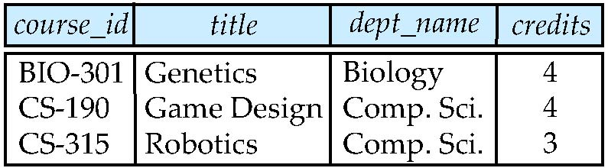
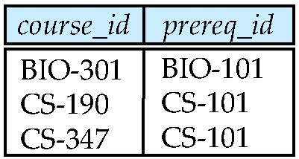
Outer Join Examples
Relation course
Relation prereq
Observe that
course information is missing CS-437
prereq information is missing CS-315
x

Slide 15
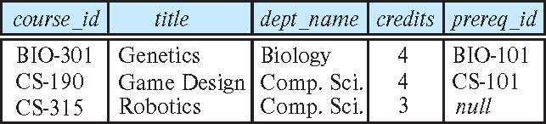
Left Outer Join
course natural left outer join prereq
In relational algebra: course ⟕ prereq

Slide 16
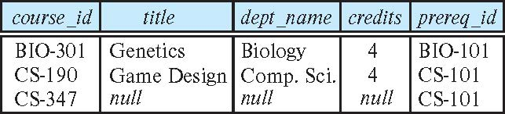
Right Outer Join
course natural right outer join prereq
In relational algebra: course ⟖ prereq

Slide 17
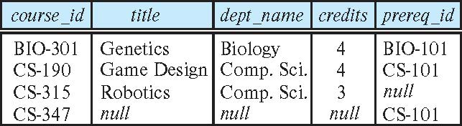
Full Outer Join
course natural full outer join prereq
In relational algebra: course ⟗ prereq

Slide 18
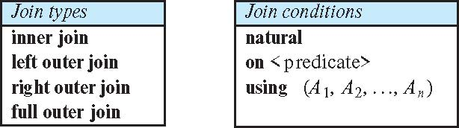
Joined Types and Conditions
Join operations take two relations and return as a result another relation.
These additional operations are typically used as subquery expressions in the from clause
Join condition – defines which tuples in the two relations match.
Join type – defines how tuples in each relation that do not match any tuple in the other relation (based on the join condition) are treated.

Slide 19
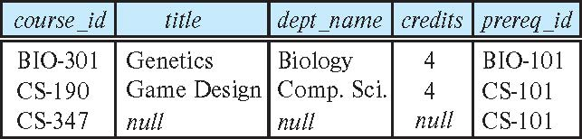
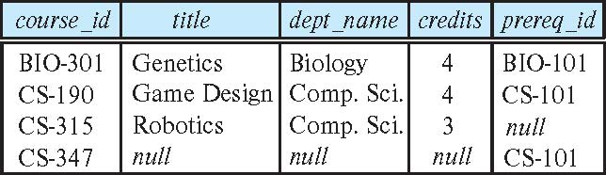
Joined Relations – Examples
course natural right outer join prereq
course full outer join prereq using (course_id)

Slide 20
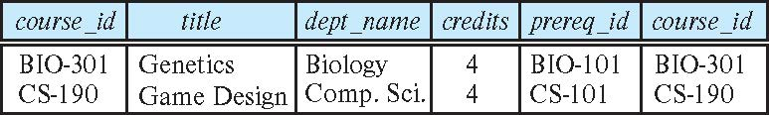
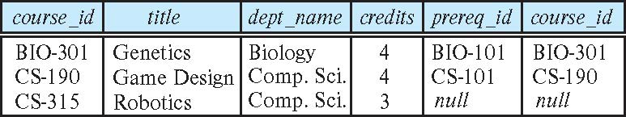
Joined Relations – Examples
course inner join prereq on course.course_id = prereq.course_id
What is the difference between the above, and a natural join?
course left outer join prereq on course.course_id = prereq.course_id

Slide 21
Joined Relations – Examples
course natural right outer join prereq
course full outer join prereq using (course_id)

Slide 22
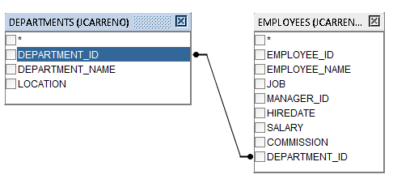
Oracle Example

Slide 23
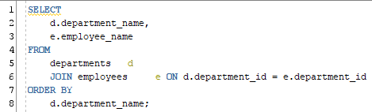
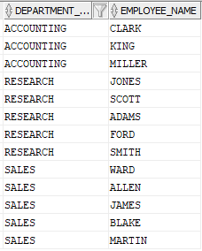

Oracle Example
Notes:
SELECT
d.department_name,
e.employee_name
FROM
departments d
JOIN employees e ON d.department_id = e.department_id
ORDER BY
d.department_name;

Slide 24
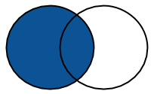
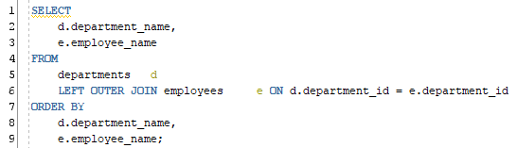
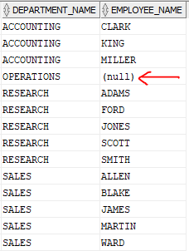
Oracle LEFT [OUTER] JOIN
Notes:
SELECT
d.department_name,
e.employee_name
FROM
departments d
LEFT OUTER JOIN employees e ON d.department_id = e.department_id
ORDER BY
d.department_name,
e.employee_name;

Slide 25

Oracle LEFT [OUTER] JOIN
Y como obtengo empleados que no están asignados a un departamento?
Notes:
SELECT
d.department_name,
e.employee_name
FROM
departments d
LEFT OUTER JOIN employees e ON d.department_id = e.department_id
ORDER BY
d.department_name,
e.employee_name;

Slide 26
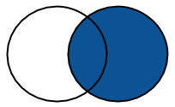
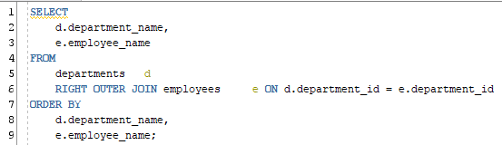
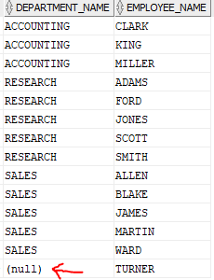
Oracle RIGHT [OUTER] JOIN
Notes:
SELECT
d.department_name,
e.employee_name
FROM
departments d
RIGHT OUTER JOIN employees e ON d.department_id = e.department_id
ORDER BY
d.department_name,
e.employee_name;

Slide 27

Oracle RIGHT [OUTER] JOIN
Y como obtengo los departamentos que no tienen empleados?
Notes:
SELECT
d.department_name,
e.employee_name
FROM
departments d
RIGHT OUTER JOIN employees e ON d.department_id = e.department_id
ORDER BY
d.department_name,
e.employee_name;

Slide 28
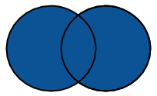
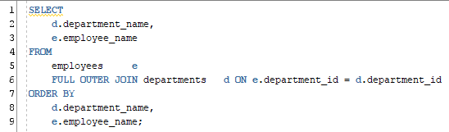
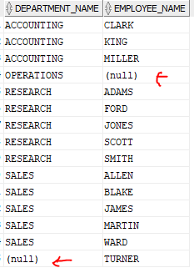
Oracle FULL [OUTER] JOIN
Notes:
SELECT
d.department_name,
e.employee_name
FROM
employees e
FULL OUTER JOIN departments d ON e.department_id = d.department_id
ORDER BY
d.department_name,
e.employee_name;

Slide 29
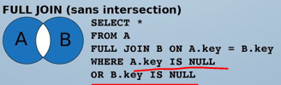
Oracle FULL [OUTER] JOIN
Y como obtengo los departamentos que no tienen empleados y empleados sin departamento?
Notes:
SELECT
d.department_name,
e.employee_name
FROM
employees e
FULL OUTER JOIN departments d ON e.department_id = d.department_id
ORDER BY
d.department_name,
e.employee_name;

Slide 30

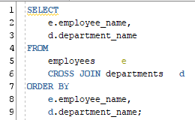
Oracle Cross join
Notes:
SELECT e.employee_name, d.department_name FROM employees e CROSS JOIN departments d ORDER BY e.employee_name, d.department_name;

Slide 31
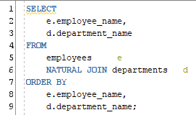
Oracle Natural Join
You can't apply any aliased filters to columns used in natural joins
Notes:
SELECT
e.employee_name,
d.department_name
FROM
employees e
NATURAL JOIN departments d
ORDER BY
e.employee_name,
d.department_name;

Slide 32
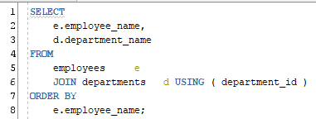
Oracle Using
You can't apply any aliased filters to columns used in natural joins
Notes:
SELECT
e.employee_name,
d.department_name
FROM
employees e
JOIN departments d USING ( department_id )
ORDER BY
e.employee_name;

